Slide 1

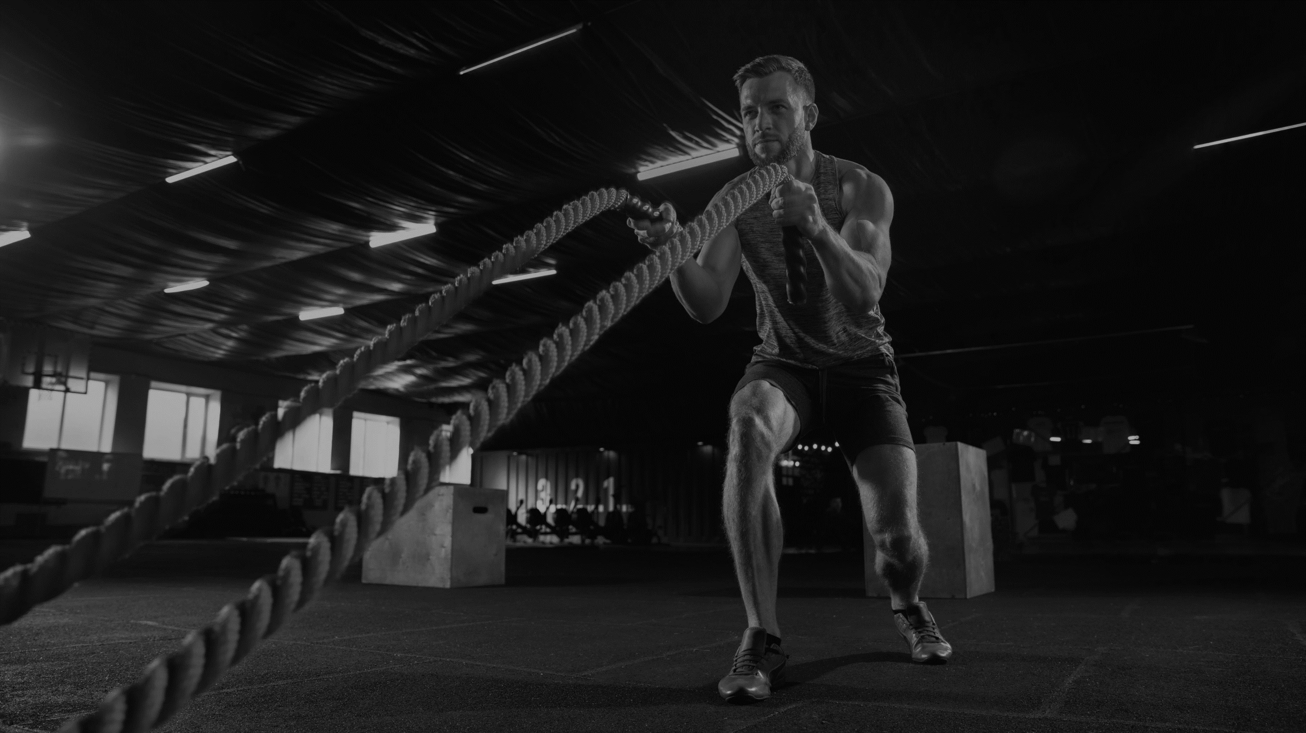





SangLehar FitnessFlow
Gym Fitness Management
A Comprehensive Platform for Membership, Workouts, and Administration
Presented By:
Sangita Rawlo (107223504043)
Leharika.k (107223504014)

Slide 2


SangLehar FitnessFlow
Contents
Introduction
System Requirements
System Architecture
UML Diagrams
Backend Features & Functionalities
Security Measures, Report & Analytics
Challenges & Solutions
Future Enhancements
Role Based Authentication and Authorization
CRUD Operations For Membership
Payment & Membership Handling
Conclusion

Slide 3

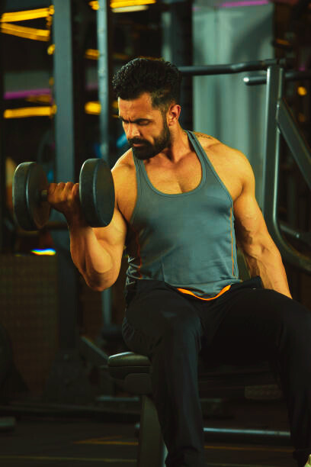

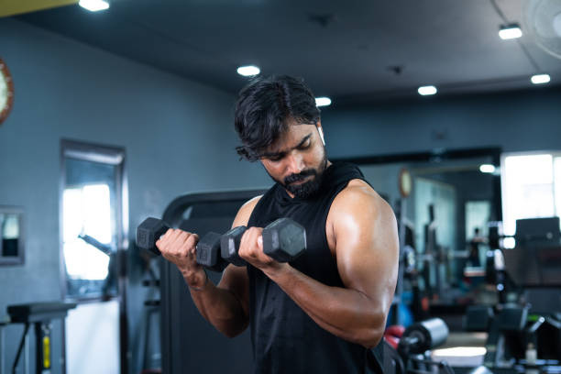
SangLehar FitnessFlow
Introduction
A Gym Fitness Management System is a software application designed to streamline and automate the daily operations of a gym or fitness center. It enhances efficiency by managing memberships, payments, class schedules, trainer assignments, and overall facility administration.
Key Features
Benefits
Membership Management
Efficiency
Billing & Payments
Improved Customer Experience
Class & Trainer Scheduling
Financial Tracking
Inventory & Equipment Management
Data Security
Reporting & Analytics

Slide 4
SangLehar FitnessFlow
System Architecture
The system follows an MVC (Model-View-Controller) structure
Users interact via frontend (HTML, CSS, JS)
Requests are handled by Django backend
Data is stored and retrieved from MySQL database
Admin, Trainers, Members, and Guests have specific roles and permissions

Slide 5

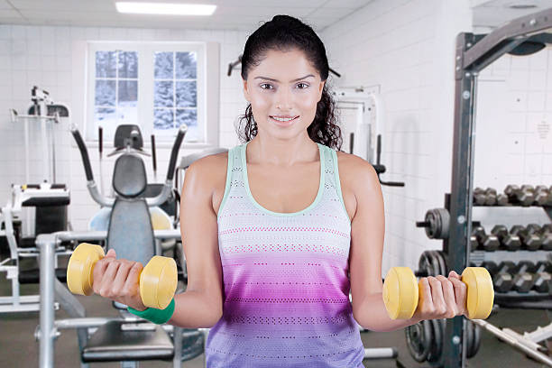
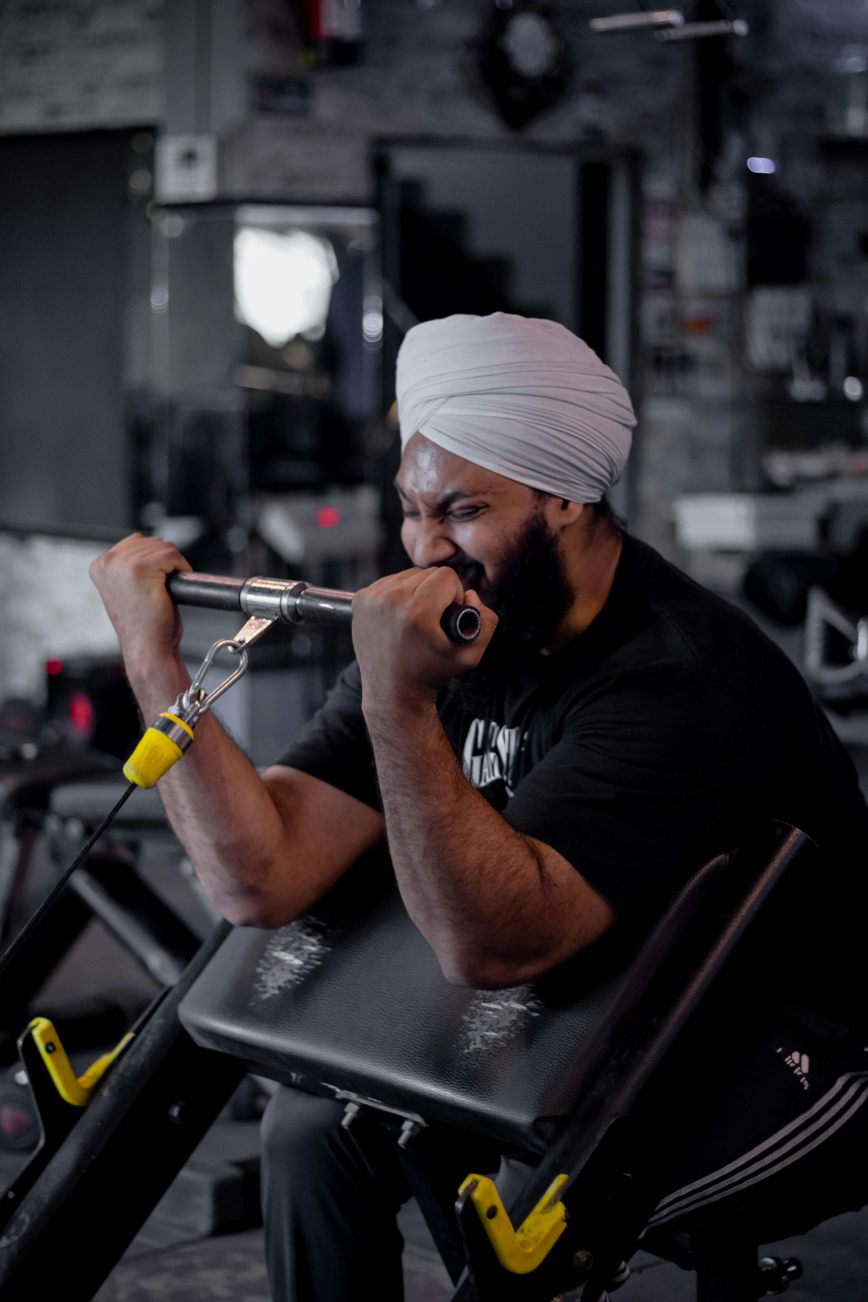
SangLehar FitnessFlow
System Requirements
System Configuration Required:
Operating System: Windows/Linux/MacOS
Processor: Intel i3 or higher
RAM: 4GB or above
Storage: 20GB free space
Browser: Chrome, Firefox, or Edge
Software Required:
Frontend: HTML5, CSS 2.1, JavaScript
Backend: Python 3.8 with Django 3.1
Database: MySQL 5.5

Slide 6


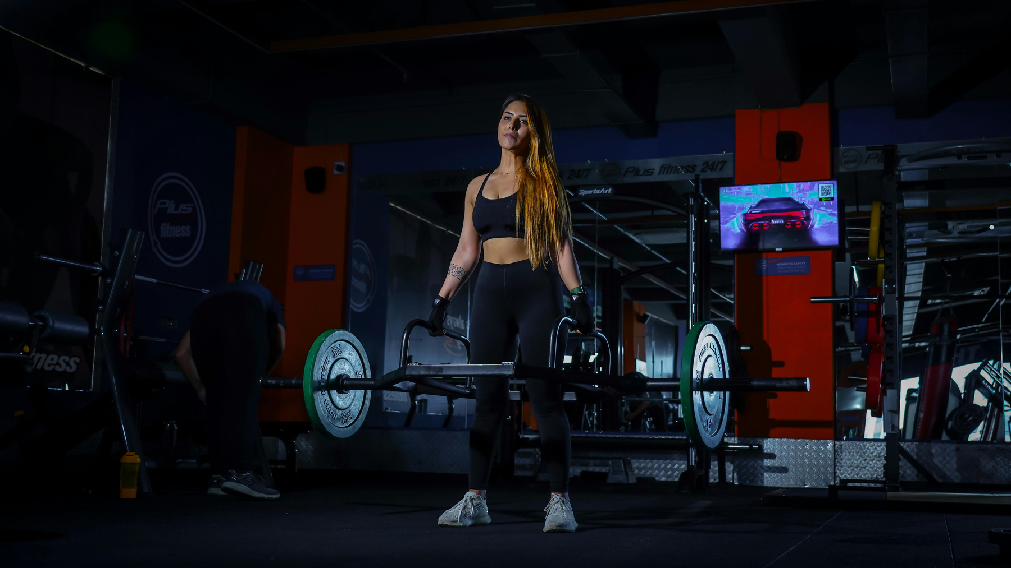
SangLehar FitnessFlow
UML Diagrams
Class Diagram
ER Diagram

Slide 7

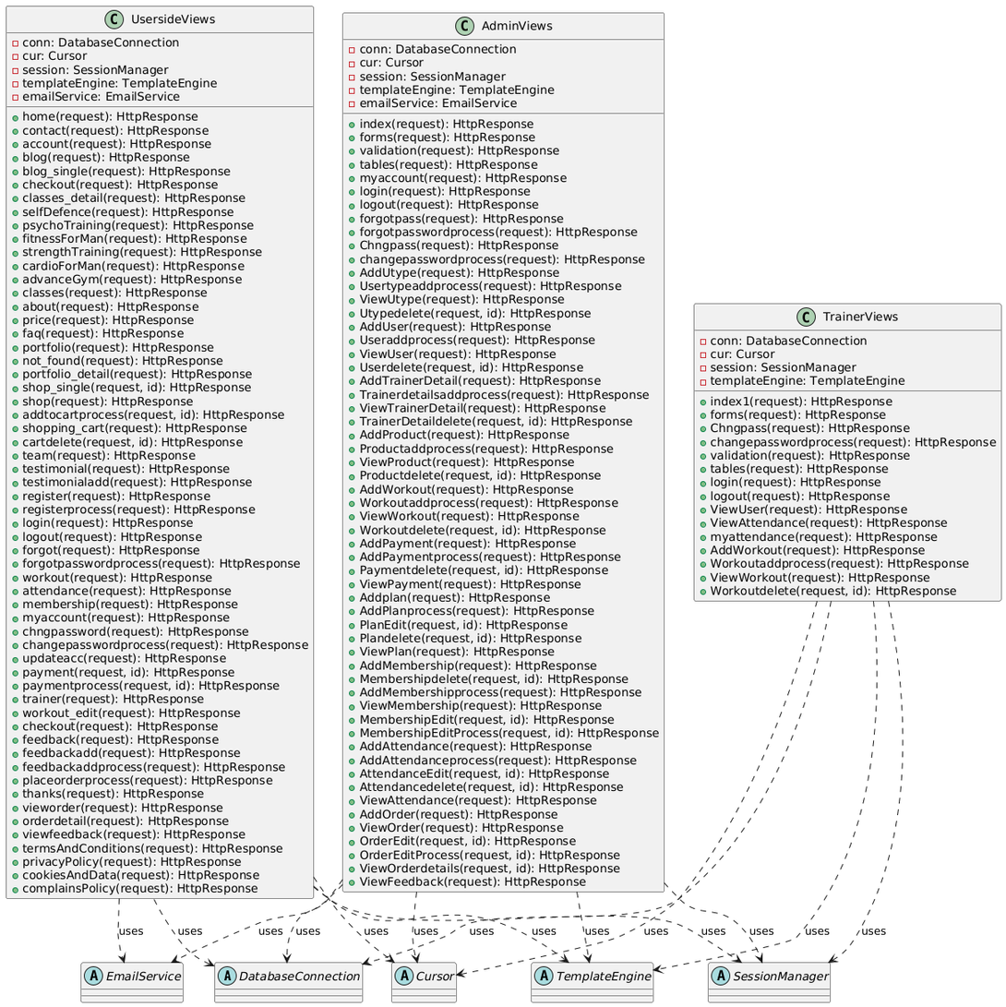
SangLehar FitnessFlow
Class Diagram

Slide 8
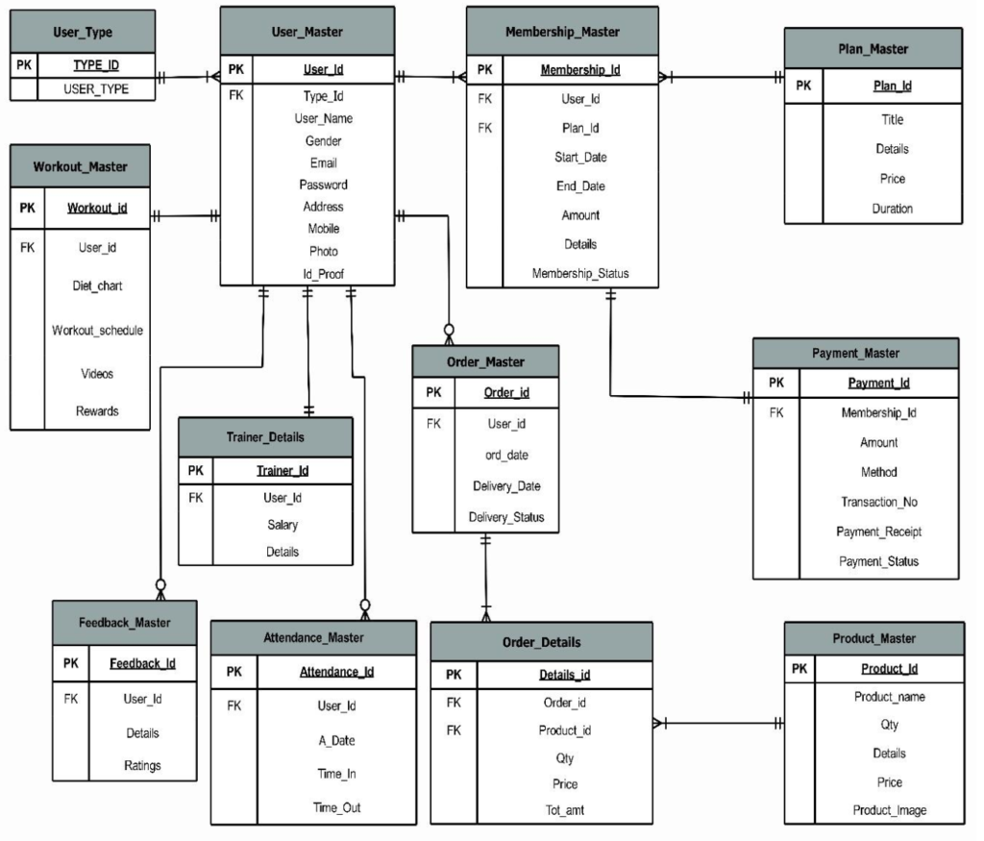
SangLehar FitnessFlow
Entity Relationship Diagram

Slide 9
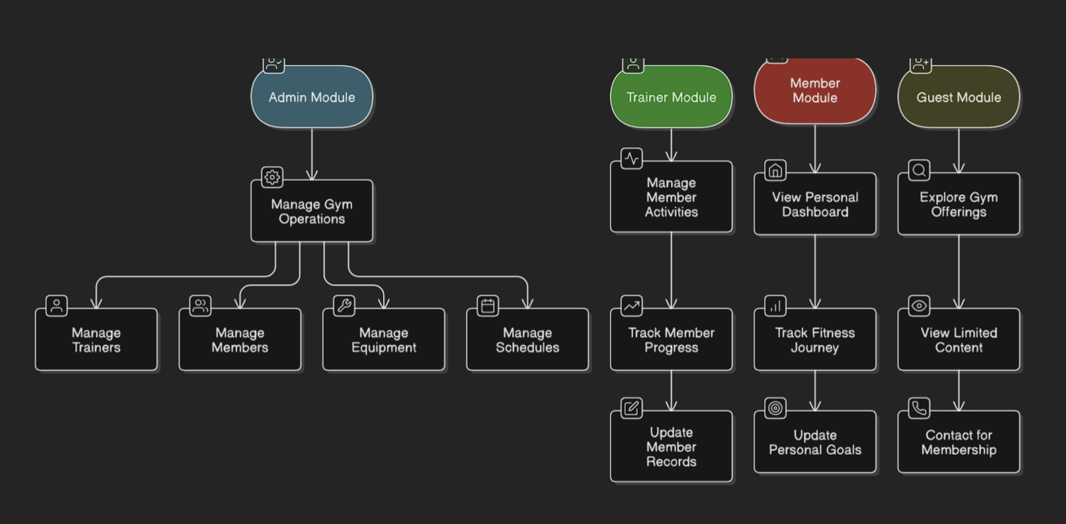
SangLehar FitnessFlow
Backend Features & Funtionalities

Slide 10
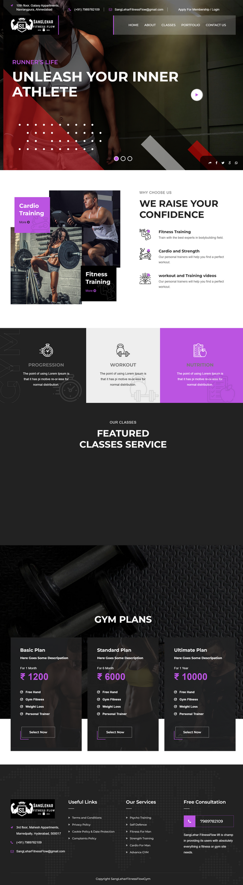

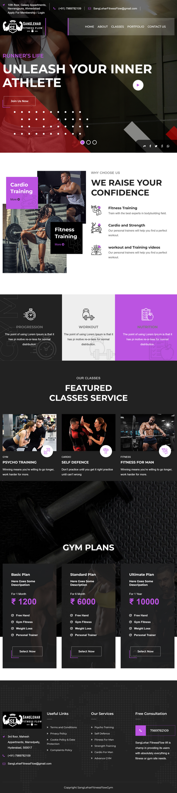
SangLehar FitnessFlow
Interfaces
Responsive interface optimized for all screen sizes, including:
Laptop screens
iPhone 14 Pro Max
iPad Pro

Slide 11

SangLehar FitnessFlow
Security Measures
User authentication (Admin, Trainer, Member, Guest roles)
CSRF Protection & Secure Payment Handling
Password encryption & Role-based access control
Report & Analytics
Membership reports
Attendance tracking
Product sales analytics
Feedback and ratings analysis

Slide 12
SangLehar FitnessFlow
Challenges
Data Security & Privacy: Handling sensitive user data securely, including payment and personal information
Performance Optimization: Ensuring fast response times, especially for large databases.
Authentication & Authorization: Implementing role-based access control for Admin, Trainers, and Members.
Scalability Issues: Managing growing users, transactions, and system load.
Data Consistency: Ensuring real-time updates and preventing data conflicts in multi-user environments.
Solutions
Data Security Measures: Used Django’s built-in security features (CSRF, XSS protection, and password hashing).
Optimized Database Queries: Used indexing, pagination, and Django ORM optimizations to speed up data retrieval.
JWT-Based Authentication: Implemented token-based authentication for secure login and role-based access.
Scalable Architecture: Used Django’s modular design and caching strategies for improved scalability.
Real-time Data Handling: Used Django signals and Celery for asynchronous tasks like email notifications and report generation.

Slide 13
SangLehar FitnessFlow
Future Enhancements
Mobile App Integration 📱 : Develop a mobile application for iOS and Android to allow users to access the system on the go.
AI-Powered Workout & Diet Recommendations 🤖 : Implement AI-based personalized workout and diet plans based on user fitness goals and progress tracking.
Live Virtual Training Sessions 🎥: Introduce live workout sessions where trainers can conduct virtual classes for remote users.
Wearable Device Integration ⌚ : Integrate with fitness trackers (like Fitbit, Apple Watch) to monitor real-time health stats.
Automated Attendance with Biometric or QR Code 📷 : Use facial recognition, fingerprint scanning, or QR codes for seamless attendance tracking.
Advanced Reporting & Analytics 📊 : Provide AI-powered insights on member progress, trainer performance, and gym revenue trends.
Gamification & Reward System 🏆 : Introduce leaderboards, badges, and reward points to keep users engaged and motivated.

Slide 14
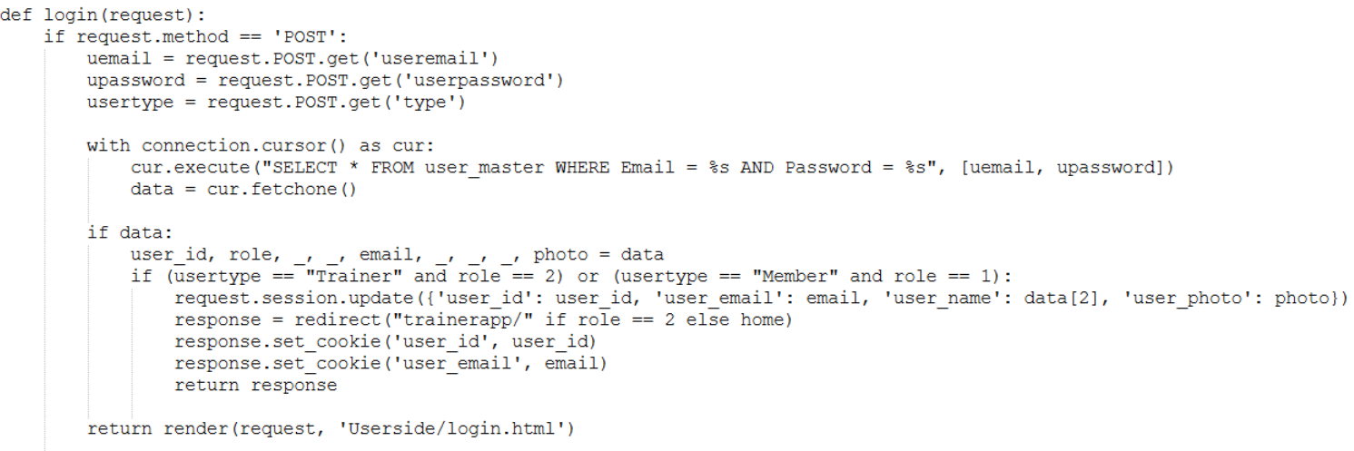
SangLehar FitnessFlow
Role-Based Authentication & Authorization
Implemented *Django’s built-in authentication system* with role-based access control.
Used *Custom User Model* to differentiate between Admin, Trainers, Members, and Guests.

Slide 15
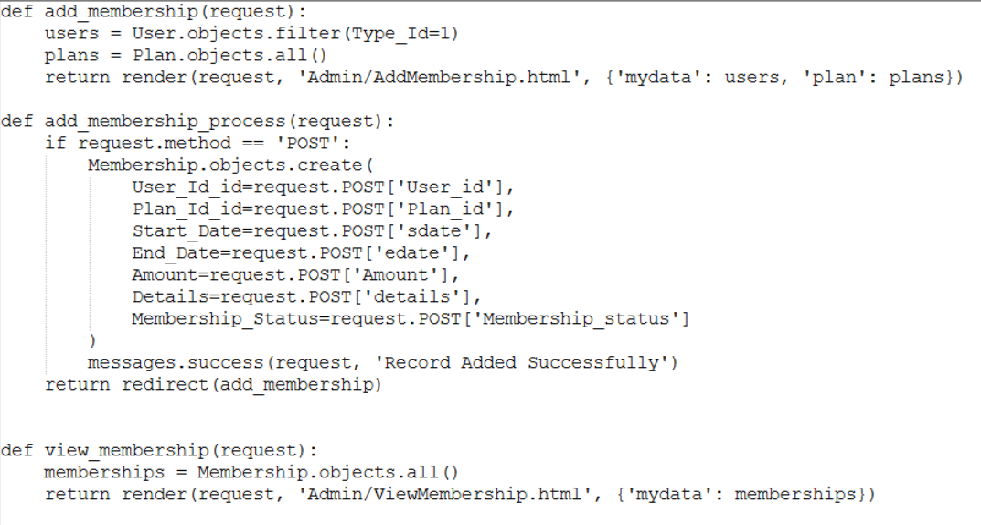
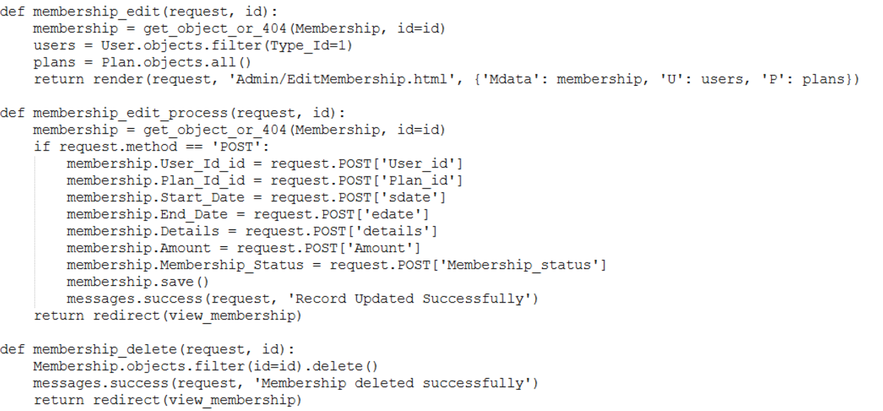
SangLehar FitnessFlow
CRUD operations on Membership
Allows Admin to Add, Edit, Delete, and View Memberships.
Uses Django ORM (Object-Relational Mapping) instead of raw SQL.
Enhancement Suggestion: Implementing Django Forms for validation & security.

Slide 16
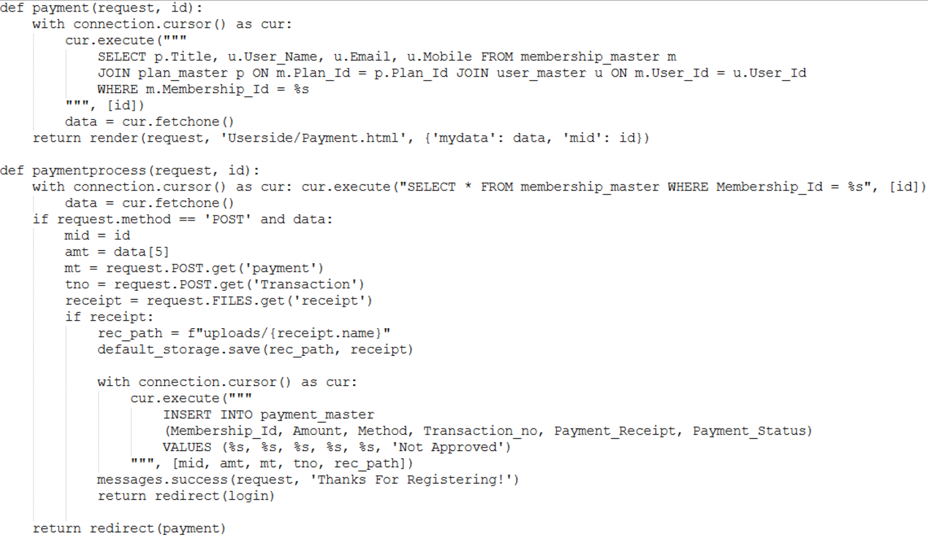
SangLehar FitnessFlow
Payment & Membership Handling
Used Django models to track *membership plans, payments, and renewal history*.
Integrated payment gateways like Stripe/Razorpay for online payments.

Slide 17
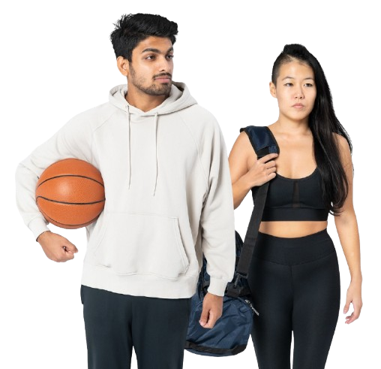
SangLehar FitnessFlow
Conclusion
The Gym Fitness Management System streamlines and automates gym operations, replacing manual processes with a digital solution. It enhances the management of members, trainers, attendance, memberships, payments, and workouts while providing a user-friendly experience.
Built with Django, MySQL, HTML5, CSS, and JS, the system ensures reliability, scalability, and efficiency. Features like online membership, payment management, workout tracking, and reports improve engagement and decision-making.
Overall, this system boosts efficiency, reduces errors, and enhances user experience, making it a valuable tool for modern gym management.

Slide 18
SangLehar FitnessFlow
Thank You!
We appreciate your interest in our Gym Fitness Management System and its impact on modern gym operations.
For any questions or discussions, feel free to ask.
Looking forward to your feedback! 😊
SangLeharFitnessFlow@gmail.com

